Slide 1
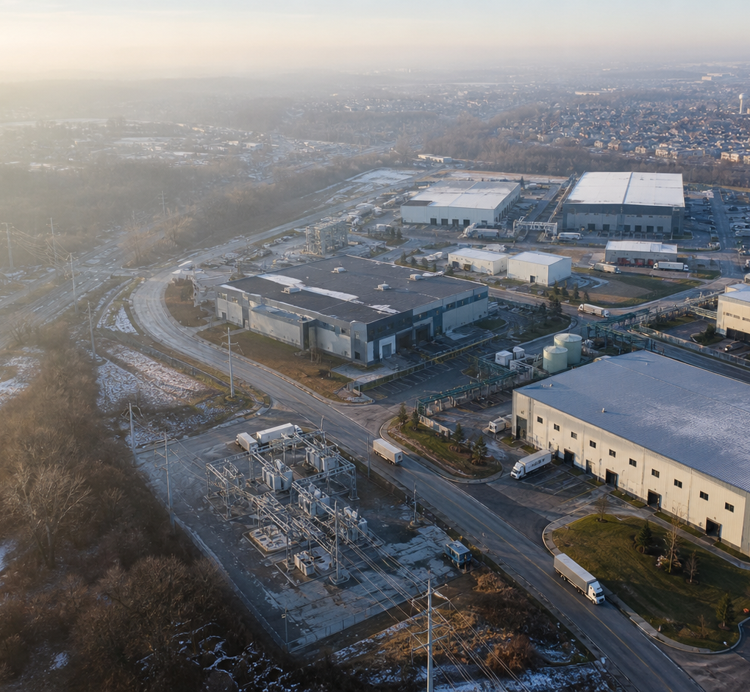
GRID FYI · SCENARIO
The Factory
Was Already There
A factory is not a building. It is a set of qualified promises that can become one plan.
FICTIONAL · ILLUSTRATIVE · NOT OUTCOME EVIDENCE
12-minute evaluation story
FICTIONAL · VERIFIED FYI FIXTURE · NO PLANT EXECUTION
01
Notes:
Open with the boundary: this is a fictional operating Scenario, not a customer deployment. The question is whether six independent firms can compose qualified promises into one inspectable delivery commitment without centralizing their complete operating models. The exact Grid FYI publication fixture passed execution, independent oracle review, and final verification. No Grid runtime, plant work, quality release, energy delivery, or outcome is established.
[Sources]
- MANUFACTURING_PARK_EDGE_SCENARIO.md — source revision 2026-08-26.2
- scenario-packages/manufacturing-park-factory-was-already-there/manifest.json — readiness R3 / fixture revision 2026-08-27.2
- scenario-packages/manufacturing-park-factory-was-already-there/evidence/execution.json
- scenario-packages/manufacturing-park-factory-was-already-there/evidence/oracle-review.md
- scenario-packages/manufacturing-park-factory-was-already-there/evidence/verification.json
- Generated editorial image: site/public/posters/manufacturing-park-winter.png

Slide 2
THE COMMITMENT
No company can make it alone
The order becomes credible only when material, work, qualification, transport, energy, release, and sequence resolve together.
420
14
98
432
factory-complete units
lots of 30
lot-level activities
qualified kits
180 / 150 / 90
10-day installation window
Optimization cannot manufacture missing inventory.
three released configuration classes
420 order kits + 12 protected buffer
FICTIONAL · VERIFIED FYI FIXTURE · NO PLANT EXECUTION · SOURCE 2026-08-26.2
02
Notes:
The business problem is not spare machine hours. A complete unit needs a complete qualified route. The fixture begins with 432 qualified critical kits: 420 for the order and 12 held as a defect and service buffer. The quantities are fictional facts, not measurements.
[Sources]
- MANUFACTURING_PARK_EDGE_SCENARIO.md — order, lot, activity, and kit facts
- src/case-studies/manufacturing-park/model.ts — authored fixture constants

Slide 3
DATA MINIMIZATION
Ask for promises, not spreadsheets
Each tenant evaluates its own reality. Only a bounded, attributable offer crosses the park boundary.
STAYS LOCAL
CROSSES THE BOUNDARY
Other customer orders
Full schedule and roster
Maintenance and recipes
Internal margins and alternatives
Full inventory position
Qualified output class
Lot size and bounded window
Product and process evidence
Expiry and withdrawal conditions
Source revision
BOUNDARY
FICTIONAL · VERIFIED FYI FIXTURE · NO PLANT EXECUTION · SOURCE 2026-08-26.2
03
Notes:
Each tenant keeps other orders, people, maintenance, tools, commercial terms, and material custody local. The park receives only a small authored promise for an already qualified result. That is deliberate data minimization and an organizational boundary, not automatic discovery or a shared data lake.
[Sources]
- MANUFACTURING_PARK_EDGE_SCENARIO.md — tenant boundary and compound-promise contract
- NIST Digital Thread for Smart Manufacturing — connected lifecycle context: https://www.nist.gov/programs-projects/digital-thread-smart-manufacturing
- GS1 EPCIS 2.0.1 — interoperable supply-chain event context: https://ref.gs1.org/standards/epcis/2.0.1/

Slide 4
COMPOSED MODEL
One composition, several engines and owners
Each engine retains its own status and evidence. Backbone carries configured symbols; it does not create manufacturing semantics.
1
2
3
4
5
6
AUTHORIZED
LOCAL FACTS
TENANT
PROMISES
PREDICATE
GATES
BUNDLE
SELECTION
PLAN +
ROUTE
REVIEWABLE
PROPOSAL
Owner
revision
Qualified
offer
Fresh · valid
compatible
Deterministic
integer model
Schedule
and movement
Authority
required
MATERIAL
PREDICATES
SELECTION
PLANNING
ROUTING
ENERGY
AUTHORITY
No single status light erases another engine’s evidence or an owner’s authority.
FICTIONAL · VERIFIED FYI FIXTURE · NO PLANT EXECUTION · SOURCE 2026-08-26.2
04
Notes:
The park composition is authored. Supply Chain projects material; predicates reject stale or incompatible offers; an authored integer model selects a bundle; Planning schedules; Routing checks movements. Each engine retains its own state. Backbone carries configured symbols; it does not understand manufacturing or produce one unified solve.
[Sources]
- MANUFACTURING_PARK_EDGE_SCENARIO.md — composed engine workflow and limitations
- scenario-packages/manufacturing-park-factory-was-already-there/claims.json — FAT-GRID-01 and FAT-GRID-02

Slide 5
COMPLETE-ROUTE ECONOMICS
The cheapest step does not make the cheapest factory
A locally attractive offer can make the complete route infeasible.
LOWEST CABINET VALUE
SELECTED COMPLETE BUNDLE
Powder-coat collision
2 lots miss final test
Complete route rejected
All hard gates resolve
Qualification remains valid
Outbound sequence preserved
≠
INFEASIBLE
POLICY-FEASIBLE
FICTIONAL · VERIFIED FYI FIXTURE · NO PLANT EXECUTION · SOURCE 2026-08-26.2
05
Notes:
The least expensive cabinet offer is pinned as a counterfactual. Its timing collides with a powder-coat changeover and pushes two lots beyond the remaining final-test window. Qualification, release, and route completeness are hard gates; they are not costs to trade away.
[Sources]
- MANUFACTURING_PARK_EDGE_SCENARIO.md — counterfactual cabinet offer and selected bundle
- src/case-studies/manufacturing-park/model.ts — authored plan constants

Slide 6
PROPOSAL STATE
PARK-PLAN-114 is a proposal
A verified fixture result reaches the decision boundary. It does not move a machine.
VERIFIED FIXTURE FACT
AUTHORITY
REQUIRED
PARK-PLAN-114
STATUS
FEASIBLE
UNITS
420
OUTBOUND MARGIN
02:38
DECISION STATE
AUTHORITY REQUIRED
NO MACHINE MOVES
BECAUSE A SOLVER RETURNED
FICTIONAL · VERIFIED FYI FIXTURE · NO PLANT EXECUTION · SOURCE 2026-08-26.2
06
Notes:
At 06:52 in fixture time, PARK-PLAN-114 covers 420 units with 158 minutes of modeled outbound margin. The timestamp is not a latency benchmark and the margin is not measured. The essential state is authority required.
[Sources]
- MANUFACTURING_PARK_EDGE_SCENARIO.md — PARK-PLAN-114 facts and evidence boundary
- src/case-studies/manufacturing-park/model.ts — plan 114 constants

Slide 7
CAUSAL EVIDENCE
Authority is plural—and evidence is not interchangeable
Every transition requires a different attributable record.
1
2
3
4
5
PROPOSAL
AUTHORIZATION
ACKNOWLEDGMENT
EXECUTION
OUTCOME
Exact revision
+ digest
Owner accepts
reservation
Instruction
received
Authoritative
report
Authoritative
observation
ACKNOWLEDGMENT = INSTRUCTION RECEIVED
No plant execution. No completed work. No outcome observed.
FICTIONAL · VERIFIED FYI FIXTURE · NO PLANT EXECUTION · SOURCE 2026-08-26.2
07
Notes:
Each tenant accepts its own reservation. Hearthstone, as contractual prime, accepts the customer commitment. Quality authorities retain holds and release. External systems act. Nia coordinates but cannot override any authority. Acknowledgment, execution report, and outcome observation are separate evidence.
[Sources]
- MANUFACTURING_PARK_EDGE_SCENARIO.md — authority and external action contract
- scenario-packages/manufacturing-park-factory-was-already-there/acceptance.json — FAT-AUTH-01

Slide 8
REACTIVE BOUNDARY
At 10:13, one authoritative fact changes
The QMS determines the hold. The model receives the permitted revision—not the private maintenance history.
Affected region
CIRRUS QMS · AUTHORITATIVE
LT-882
48-03
held lot
9
unstarted refrigerant lots
REFERENCE CHECK
OUT OF TOLERANCE
Previous accepted check 08:00
Future availability FALSE
Held population LOT 48-03
2
WIP shuttle routes
?
exact retained / repaired counts
FICTIONAL · VERIFIED FYI FIXTURE · NO PLANT EXECUTION · SOURCE 2026-08-26.2
08
Notes:
Cirrus QMS, not Grid, determines the hold. Cirrus publishes a changed fact and permitted evidence. The affected region includes lot 48-03, nine unstarted refrigerant-circuit lots, dependent reservations, two WIP routes, relevant energy intervals, and the affected outbound sequence. Exact retained and repaired activity counts remain indeterminate and are not invented.
[Sources]
- MANUFACTURING_PARK_EDGE_SCENARIO.md — 10:13 LT-882 disturbance and affected region
- src/case-studies/manufacturing-park/model.ts — disturbance and explicit indeterminate fields

Slide 9
BOUNDED REPAIR
Repair the affected region, not the whole world
The selected alternative preserves the complete route—even though it costs more locally.
01
WAIT FOR LT-882
02
ONE NEIGHBORING LINE
03
TWO CELLS + 2 EXCHANGES
LOCAL APPEAL
LOCAL APPEAL
LOCAL APPEAL
Lowest direct cost
Joining capacity fits
Higher local cost
COMPLETE-ROUTE RESULT
COMPLETE-ROUTE RESULT
COMPLETE-ROUTE RESULT
Misses installation sequence
Test + dock windows fail
Complete route remains feasible
PARK-PLAN-115
FEASIBLE
02:09 modeled margin
NEW AUTHORITY REQUIRED
FICTIONAL · VERIFIED FYI FIXTURE · NO PLANT EXECUTION · SOURCE 2026-08-26.2
09
Notes:
Waiting misses the installation sequence. Moving all work to one line overloads later test and dock windows. Splitting work across two qualified cells and exchanging two test windows is locally more expensive but preserves the complete route. PARK-PLAN-115 has 129 minutes of authored margin and needs new authority.
[Sources]
- MANUFACTURING_PARK_EDGE_SCENARIO.md — three repair alternatives and PARK-PLAN-115
- src/case-studies/manufacturing-park/model.ts — repair alternative constants

Slide 10
CONSTRAINED FLEXIBILITY
Energy flexibility cannot consume protected production
A credible portfolio keeps quality-critical work protected and leaves missing dispatch evidence visible.
Eligible examples
Protected
820 kW
Delay unstarted laser nests
Defer the next oven firing
Defer a compressor restart
Exchange unstarted final-test slots
Active powder-coat cure
Evacuation and charging
Non-interruptible quality cycles
16:00–17:30
18 five-minute intervals
AUTHORED PORTFOLIO CLAIM
822–836 kW each interval
MISSING EVIDENCE
Exact profile not materialized
tariff · ramp · rebound · action kW · dispatch receipt · meter receipt
FICTIONAL · VERIFIED FYI FIXTURE · NO PLANT EXECUTION · SOURCE 2026-08-26.2
10
Notes:
Energy is another constrained promise. The facility energy manager must accept an exact portfolio revision, and plant systems dispatch it. The fixture declares a feasible envelope but lacks the interval profile, tariff ceiling, action-level kW, and authoritative dispatch and meter receipts needed to establish delivery.
[Sources]
- MANUFACTURING_PARK_EDGE_SCENARIO.md — demand-response request, protected production, and evidence gaps
- src/case-studies/manufacturing-park/model.ts — energy envelope and indeterminate fields

Slide 11
EVALUATION BOUNDARY
What Grid contributes—and what remains unqualified
The credible claim is compositional. The gaps are part of the design contract.
COMPOSED GRID HYPOTHESIS
NOT ESTABLISHED
Typed, versioned facts
Configured reactive dependencies
Constraints and bounded alternatives
Inspectable proposal + local evidence
Governed authority workflow primitives
Turnkey manufacturing exchange
Automatic manufacturing semantics
One unified distributed solver
Plant safety control
Automatic award or quality certification
FICTIONAL · VERIFIED FYI FIXTURE · NO PLANT EXECUTION · SOURCE 2026-08-26.2
11
Notes:
Documented Grid concepts can participate in an inspectable model. A real deployment still needs adapters, domain schemas, identity, policy, reservation semantics, operating controls, external receipts, and qualification. This Scenario does not establish a turnkey manufacturing exchange or plant safety control.
[Sources]
- scenario-packages/manufacturing-park-factory-was-already-there/claims.json — FAT-GRID-01 and FAT-GRID-02
- MANUFACTURING_PARK_EDGE_SCENARIO.md — product qualification boundary

Slide 12
NEXT PROOF
Turn the Scenario into a controlled evaluation
The publication fixture is verified. Intended-environment evidence is the next proof.
01
MATERIALIZE
02
EXECUTE + REVIEW
03
PILOT SAFELY
Exact offers, routes, schedules, digests, energy profile, and negative cases.
Pinned product build, retained evidence, independent oracle review, verified outputs.
Shadow mode, named authorities, real receipts, fail-closed measures, privacy and reliability.
CURRENT STATE
MATERIALIZED
EXECUTION PASSED
ORACLE REVIEWED
VERIFIED
OUTCOME UNOBSERVED
FICTIONAL · VERIFIED FYI FIXTURE · NO PLANT EXECUTION · SOURCE 2026-08-26.2
12
Notes:
The exact Grid FYI publication fixture is verified: its deterministic execution passed, its oracle received independent review, and a distinct verifier compared the retained evidence. The next proof is controlled intended-environment evaluation with real authorities and systems of record. A promise becomes real only when named owners accept it and authoritative systems report physical work. Grid runtime, plant integration, quality release, energy delivery, and outcomes remain unproven.
[Sources]
- MANUFACTURING_PARK_EDGE_SCENARIO.md — gaps ledger and controlled-evaluation path
- scenario-packages/manufacturing-park-factory-was-already-there/manifest.json — readiness R3 / fixture revision 2026-08-27.2
- scenario-packages/manufacturing-park-factory-was-already-there/evidence/execution.json
- scenario-packages/manufacturing-park-factory-was-already-there/evidence/oracle-review.md
- scenario-packages/manufacturing-park-factory-was-already-there/evidence/verification.json

